Slide 1
Dimensional model

Slide 2
What do we know so far about … FACTS?
“What is the process measuring?”
Fact types:
  Numeric
    Additive
    Semi-additive
    Non-additive (avg, count..)
  Textual (rarely)
Derived facts
Fact tables
  90% of database (many rows, few columns)
  contain FKs to dimensions PKs
  Many to many between dimensions
Fact tables types:
  Transaction fact tables
  tbc

Slide 3
What do we know so far about … DIMENSIONS?
“How do business people describe the data resulting from the business process measurement events?”
Dimension tables:
  10% of database (many columns, few rows)
Flags and Indicators as Textual Attributes
Attributes with Embedded Meaning
Numeric Values as Attributes or Facts

Slide 4
More about FACTS…
NO null FKs in fact tables
  WHY?
    Referential integrity violated
    No join on null keys
It’s ok to have nulls as metrics in fact tables
  they’re properly handled in aggregate functions such as SUM, MIN, MAX, COUNT, and AVG which do the “right thing” with nulls.
  Substituting a zero instead would improperly skew these aggregated calculations

Slide 5
More about DIMENSIONS…
NO null values for attributes (use unknown or not applicable instead)
  WHY?
    Null values disappear in pull-down menus of possible attribute values
    special syntax is required to identify them
    If users sum up facts by grouping on a fully populated dimension attribute, and then alternatively, sum by grouping on a dimension attribute with null values, they’ll get different query results.

Slide 6
More about DIMENSIONS…
Degenerate Dimensions (DD)
  Operational transaction control numbers such as order numbers, invoice numbers, and bill-of-lading numbers usually give rise to empty dimensions and are represented as degenerate dimensions in transaction fact tables. The degenerate dimension is a dimension key without a corresponding dimension table.

Slide 7
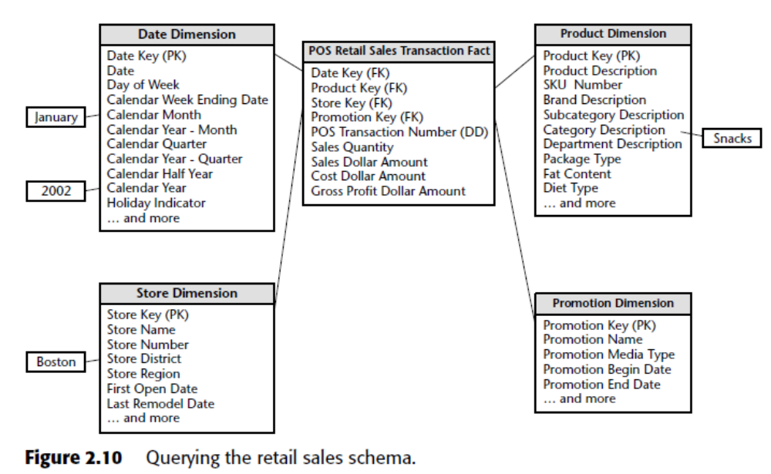

Slide 8
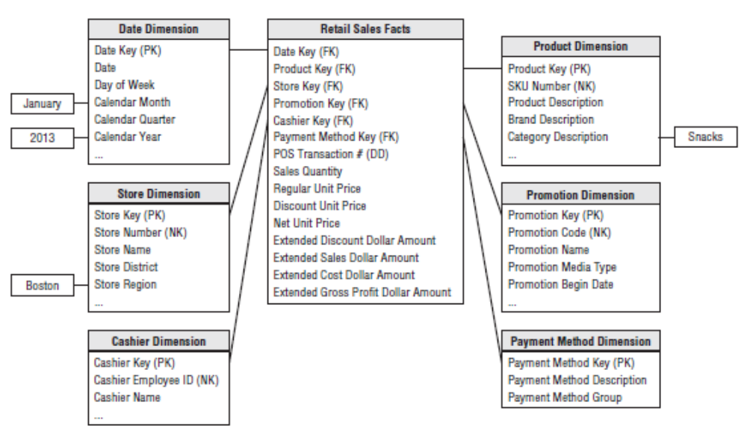
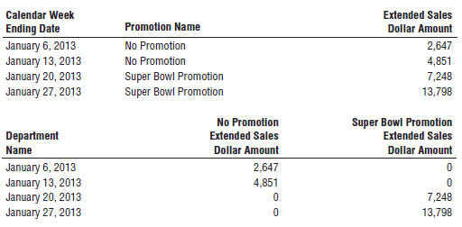
Retail Schema in Action

Slide 9
Retail Schema Extensibility
frequent shopper program
New dimension attributes
New dimensions
New measured facts

Slide 10
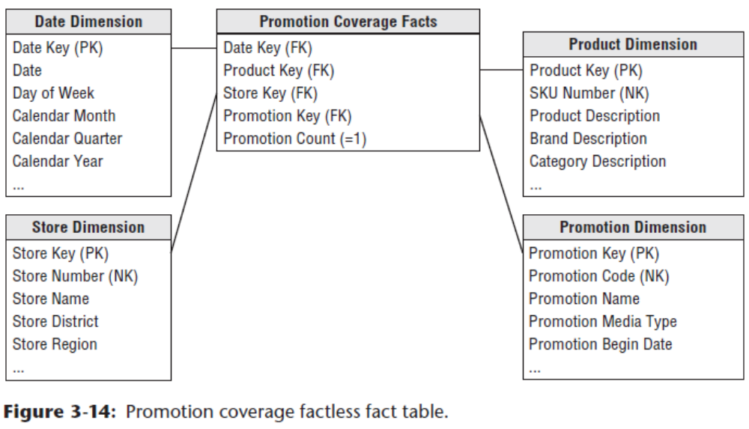
More about FACTS…
Factless Fact Tables
    What products were on promotion but did not sell?

Slide 11
Dimension and Fact Table Keys
Dimension Table Surrogate Keys
  Every join between dimension and fact tables in the data warehouse should be based on meaningless integer surrogate keys. You should avoid using a natural key as the dimension table’s primary key.
Fact Table Surrogate Keys
  PK of a fact table typically consists of a subset of the table’s FKs and/or degenerate dimension.

Slide 12
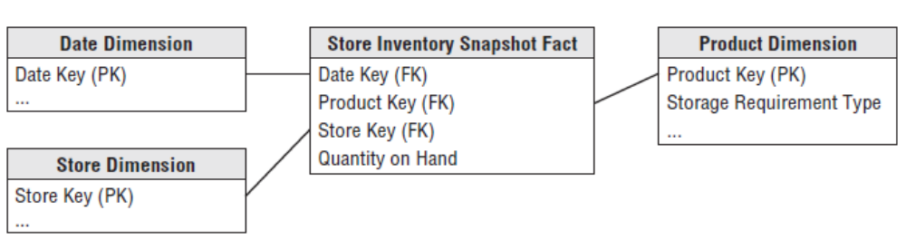
Inventory Business Process
Inventory Periodic Snapshot

Slide 13
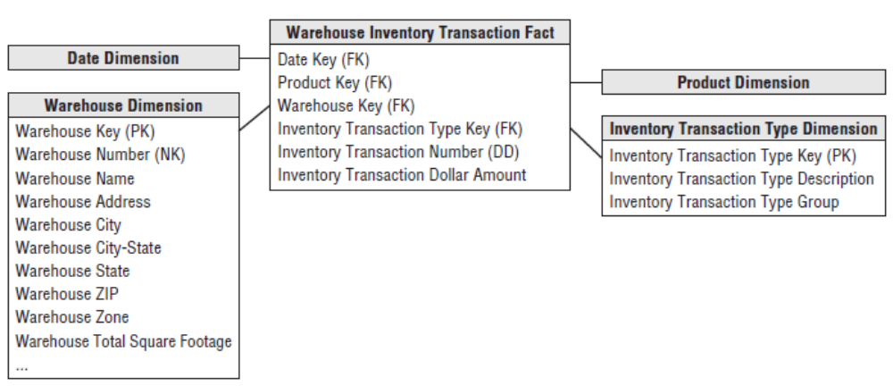
Inventory Business Process
Inventory Transactions

Slide 14
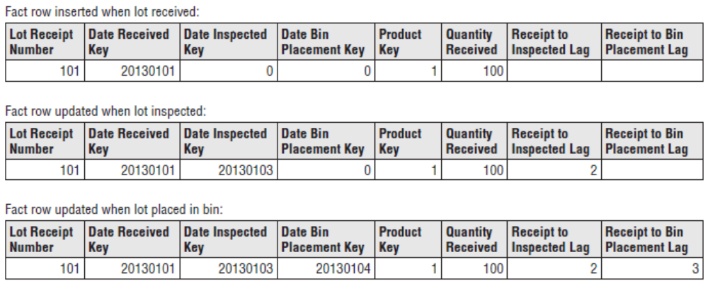
Inventory Business Process
Inventory Accumulating Snapshot

Slide 15
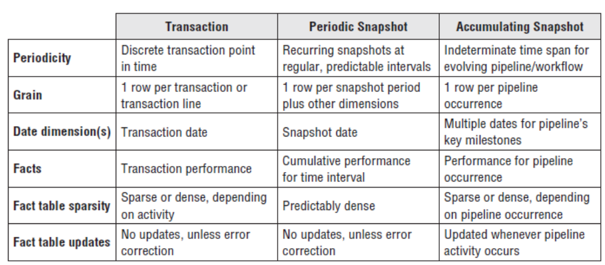
Fact Table Types

Slide 16
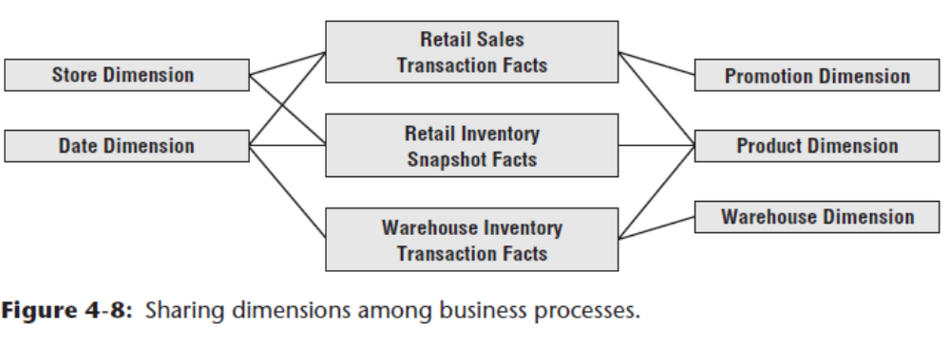
Data Warehouse Bus Architecture
By defining a standard bus interface for the DW/BI environment, separate dimensional models can be implemented by different groups at different times. The separate business process subject areas plug together and usefully coexist if they adhere to the standard.

Slide 17
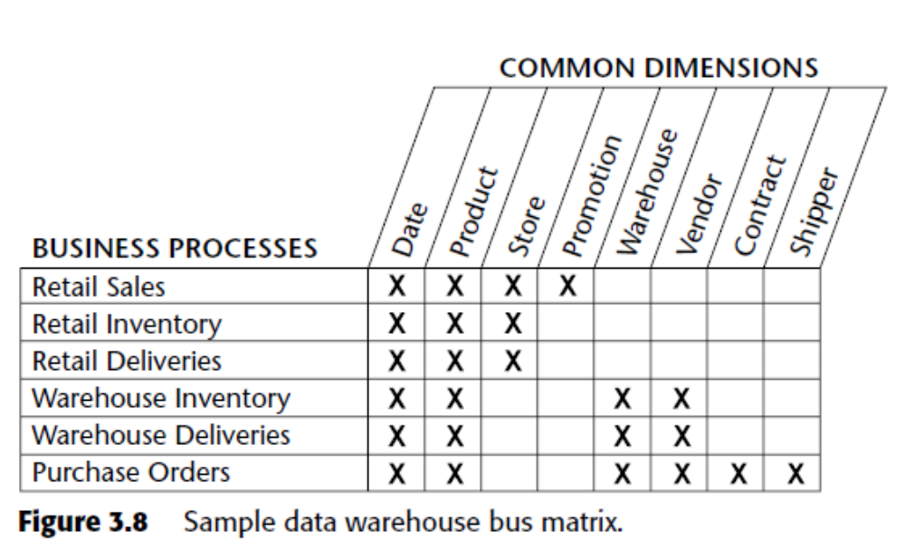
Data Warehouse Bus Matrix

Slide 18
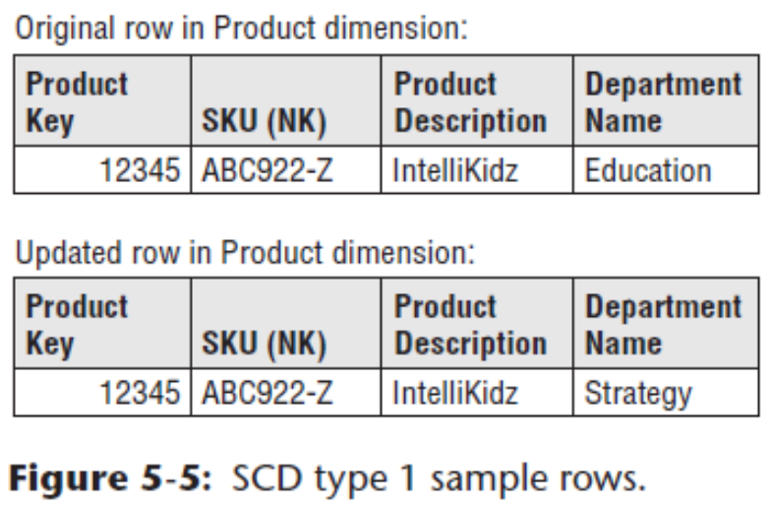
Slowly Changing Dimension (SCD)
Type 0: Retain Original
Type 1: Overwrite
  easy to implement, but it does not maintain any history of prior attribute values.

Slide 19
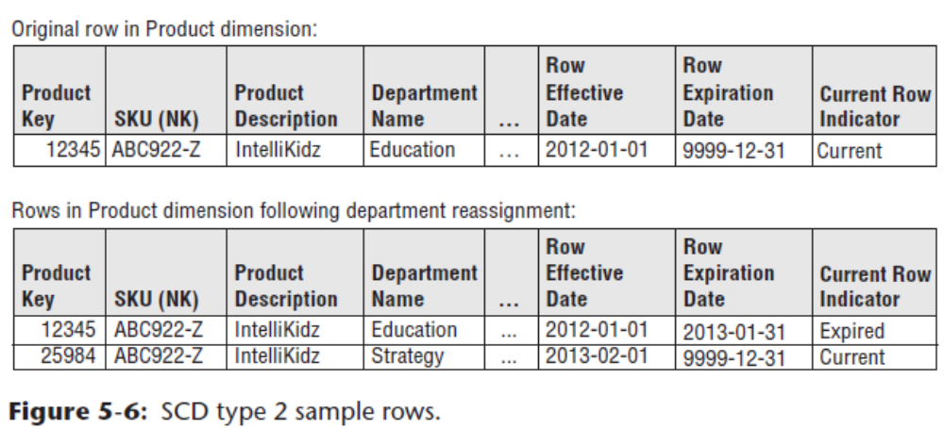
Slowly Changing Dimension (SCD)
Type 2: Add New Row
  the primary workhorse technique for accurately tracking slowly changing dimension attributes.

Slide 20
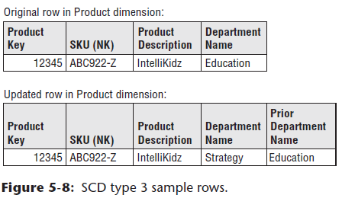
Slowly Changing Dimension (SCD)
Type 3: Add New Attribute
  The type 3 slowly changing dimension technique enables you to see new and historical fact data by either the new or prior attribute values, sometimes called alternate realities.

Slide 21
Dimensional model
Goals: user understandability, query performance, resilience to change
Atomic data
Adherence to bus architecture

Slide 22
Case study – Babes-Bolyai University
3-5 persons teams
create a dimensional model of data available at UBB
consider one business process
identify different types of facts and dimensions

